Slide 1

Specific Heat Capacity of Low Temperature Water–Ammonia Mixtures Down to the Eutectic
Bing Hong Chua^{1,2}
Mentors: Dr. Steven D. Vance²
Dr. Mathieu Choukroun²
¹Nanyang Technological University, Singapore
²Jet Propulsion Laboratory, California Institute of Technology

Slide 2
Abstract
Obtained novel specific heat measurements of H₂O–NH₃ mixtures
Highlight inaccuracies in the currently adopted equation of state
Provide better constraints for constructing a new equation of state
Contribute to improving accuracy of planetary models
Notes:
0:47

Slide 3

Introduction
the water–ammonia system
Abundant in the outer solar system
Interior Structure
anti-freeze enables subsurface oceans
A. Angelich (NRAO/AUI/NSF)/ ALMA/ ESO

Slide 4
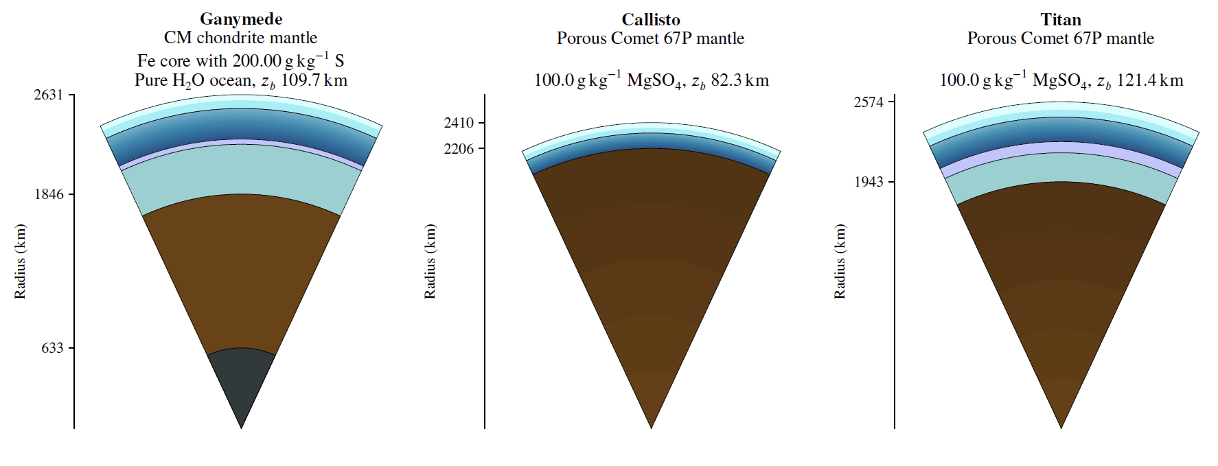
Introduction
the pipeline
Geophysical Models
Equations of State (EoS)
Thermodynamic Data
isobaric specific heat capacity (C_{p})
Styczinski et al., 2022 (submitted)

Slide 5
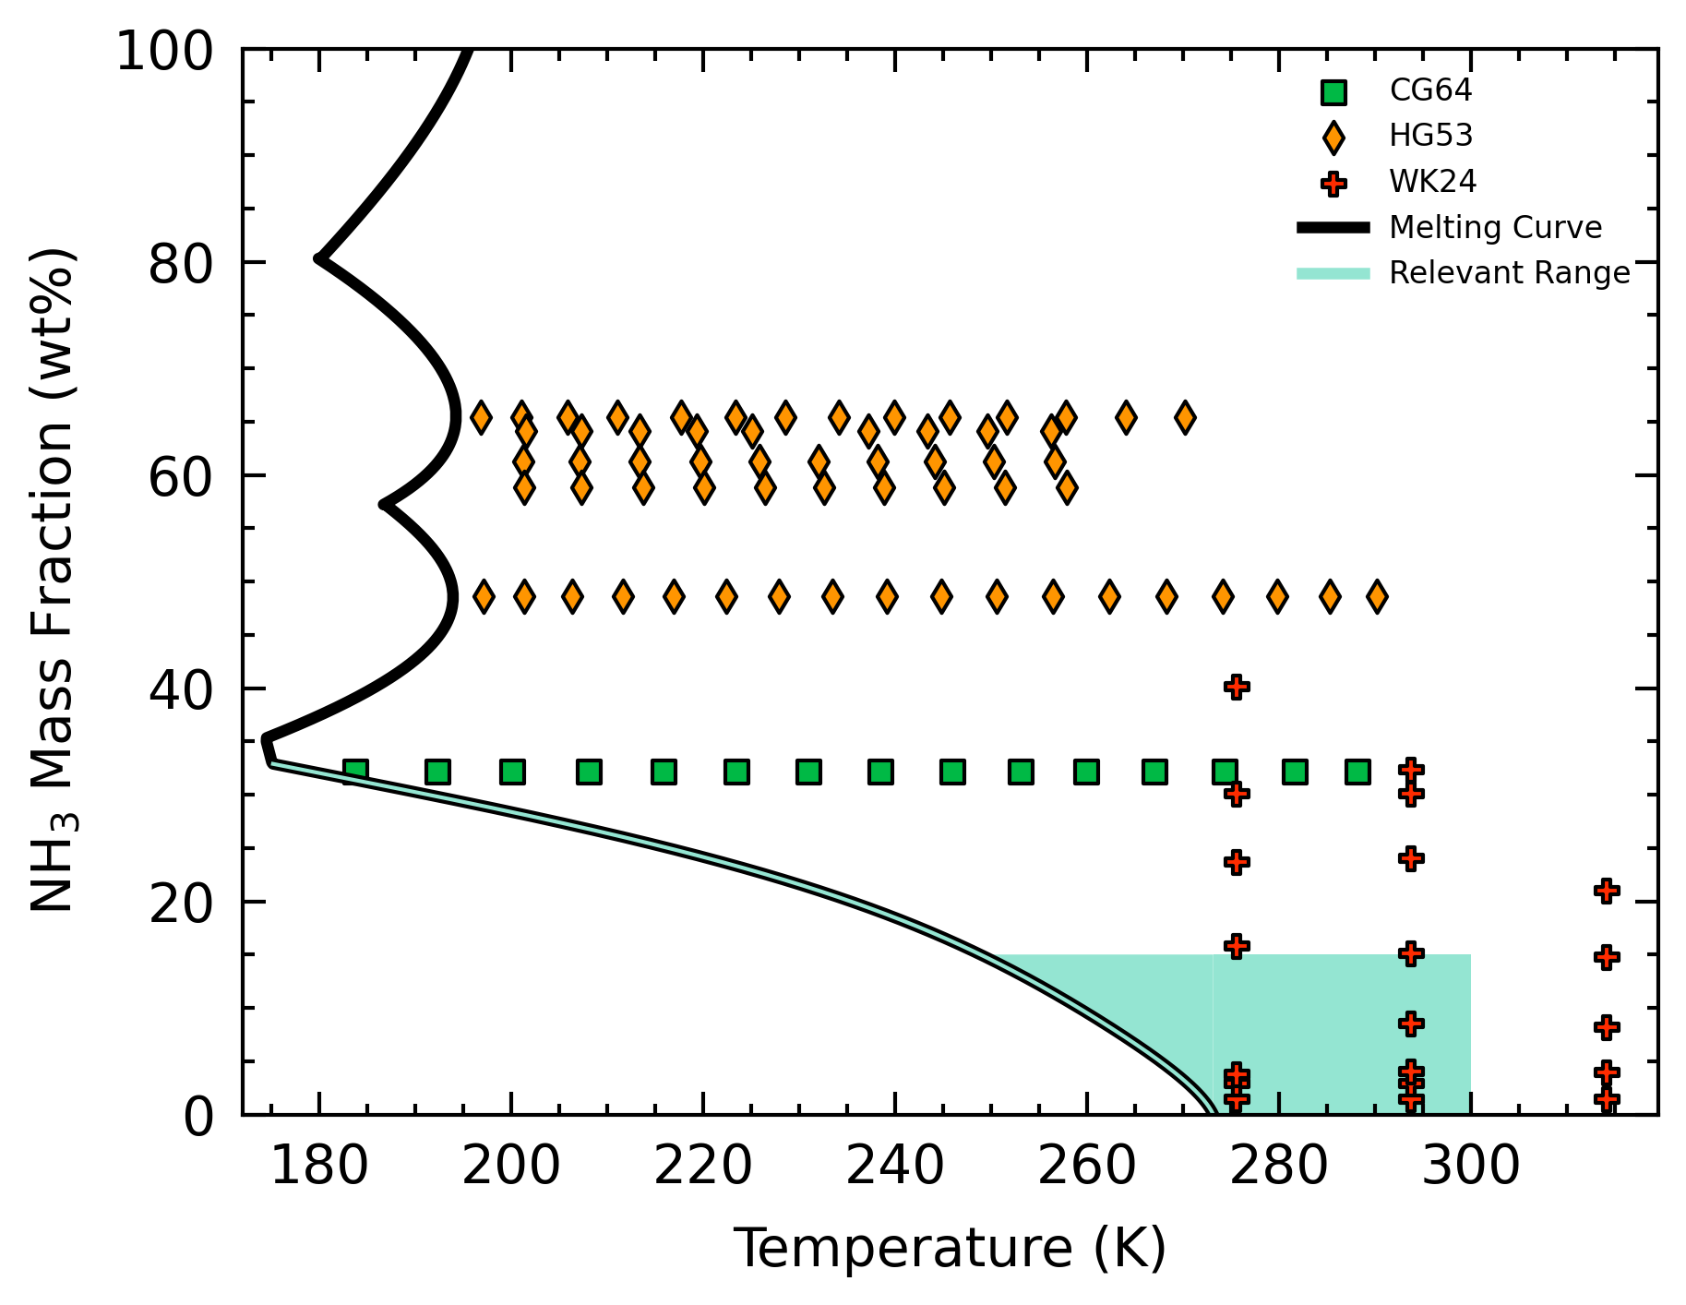
Introduction
the current C_{p} understanding
Current EoS by Tillner-Roth & Friend, 1998
Sparse data in the parameter space relevant to planetary studies (low T, low composition)

Slide 6
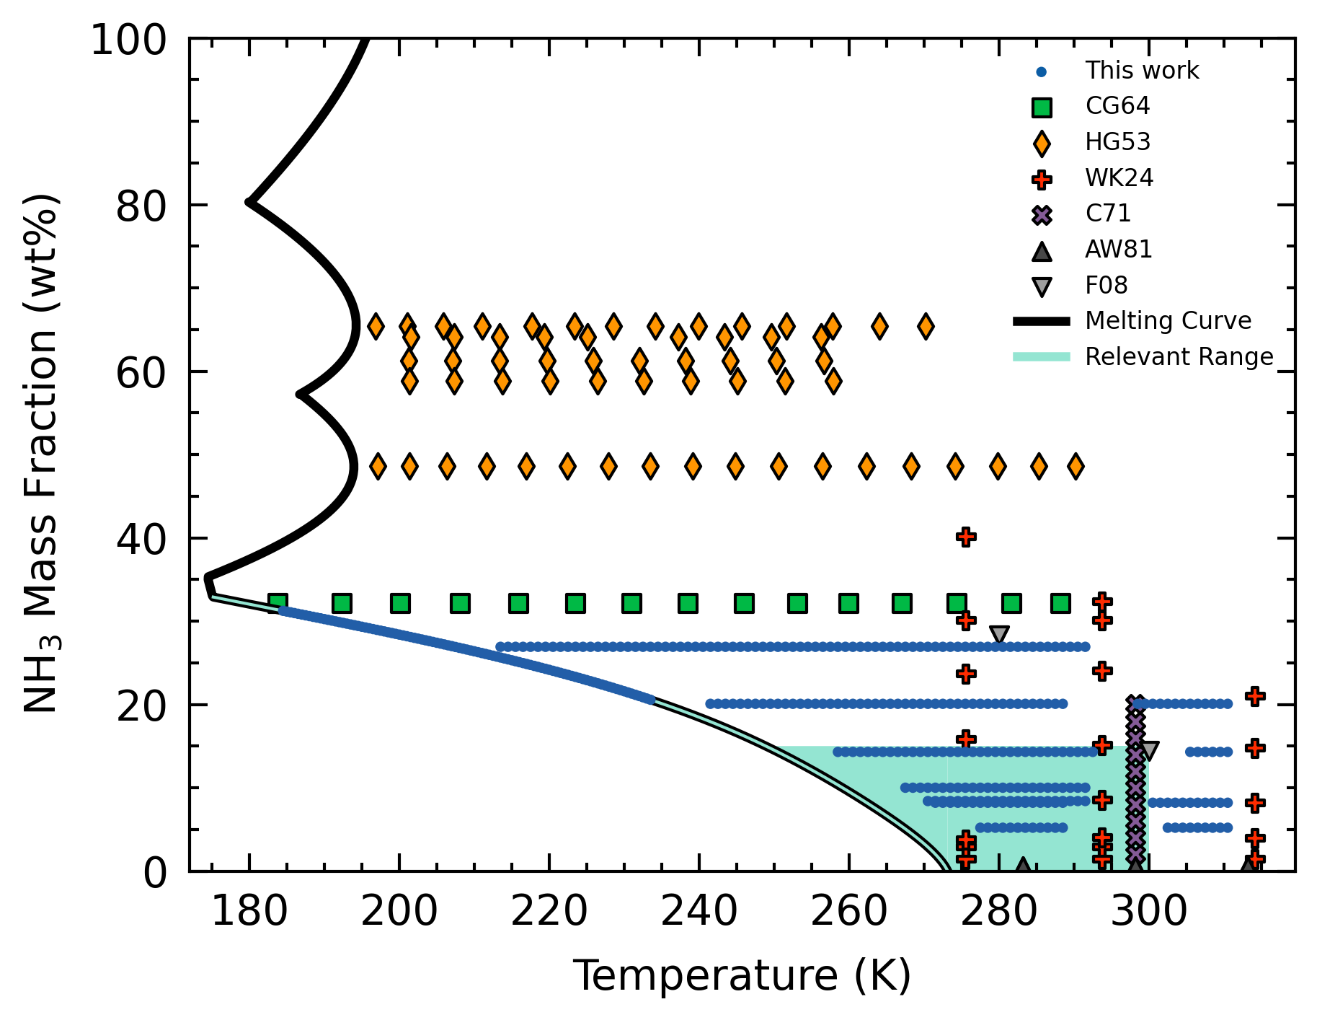
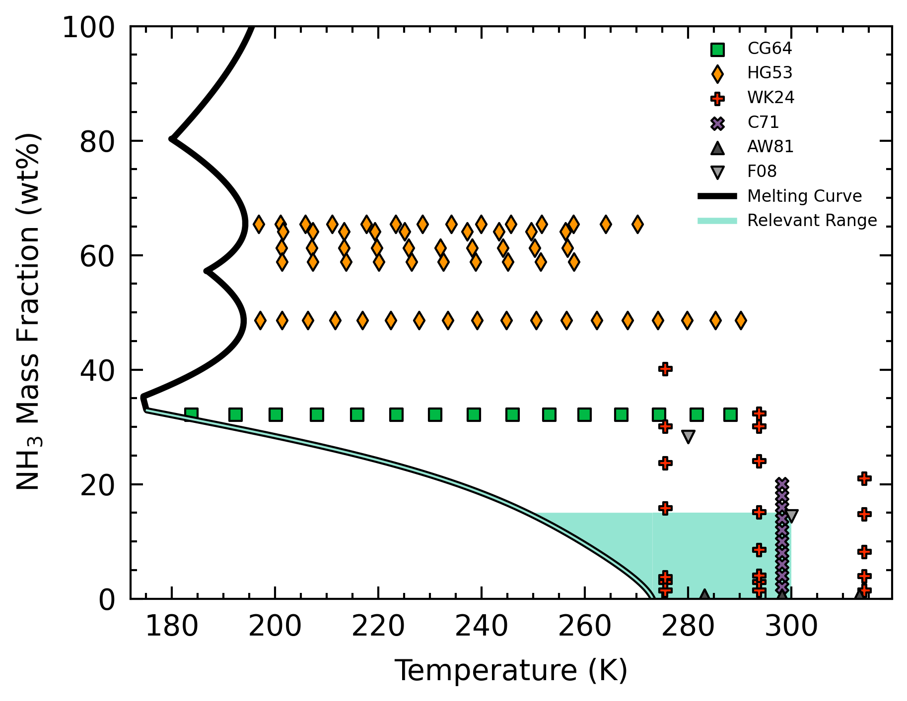
Introduction
the current C_{p} understanding
Current EoS by Tillner-Roth & Friend, 1998
Sparse data in the parameter space relevant to planetary studies (low T, low composition)

Slide 7
Introduction
the current C_{p} understanding
Current EoS by Tillner-Roth & Friend, 1998
Sparse data in the parameter space relevant to planetary studies (low T, low composition)
Motivation provide novel C_{p} data in desired parameter space
Notes:
3:10

Slide 8
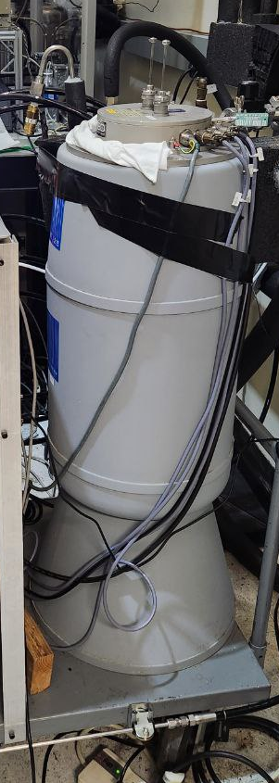
Methods
differential scanning calorimetry (DSC)
sample
reference
Principle: measures difference in heat flow between sample and reference cells
Temperature profile
Cool to 120 K
Heat at 0.1 K min⁻¹
End at 300 or 320 K
~4 days per experiment

Slide 9
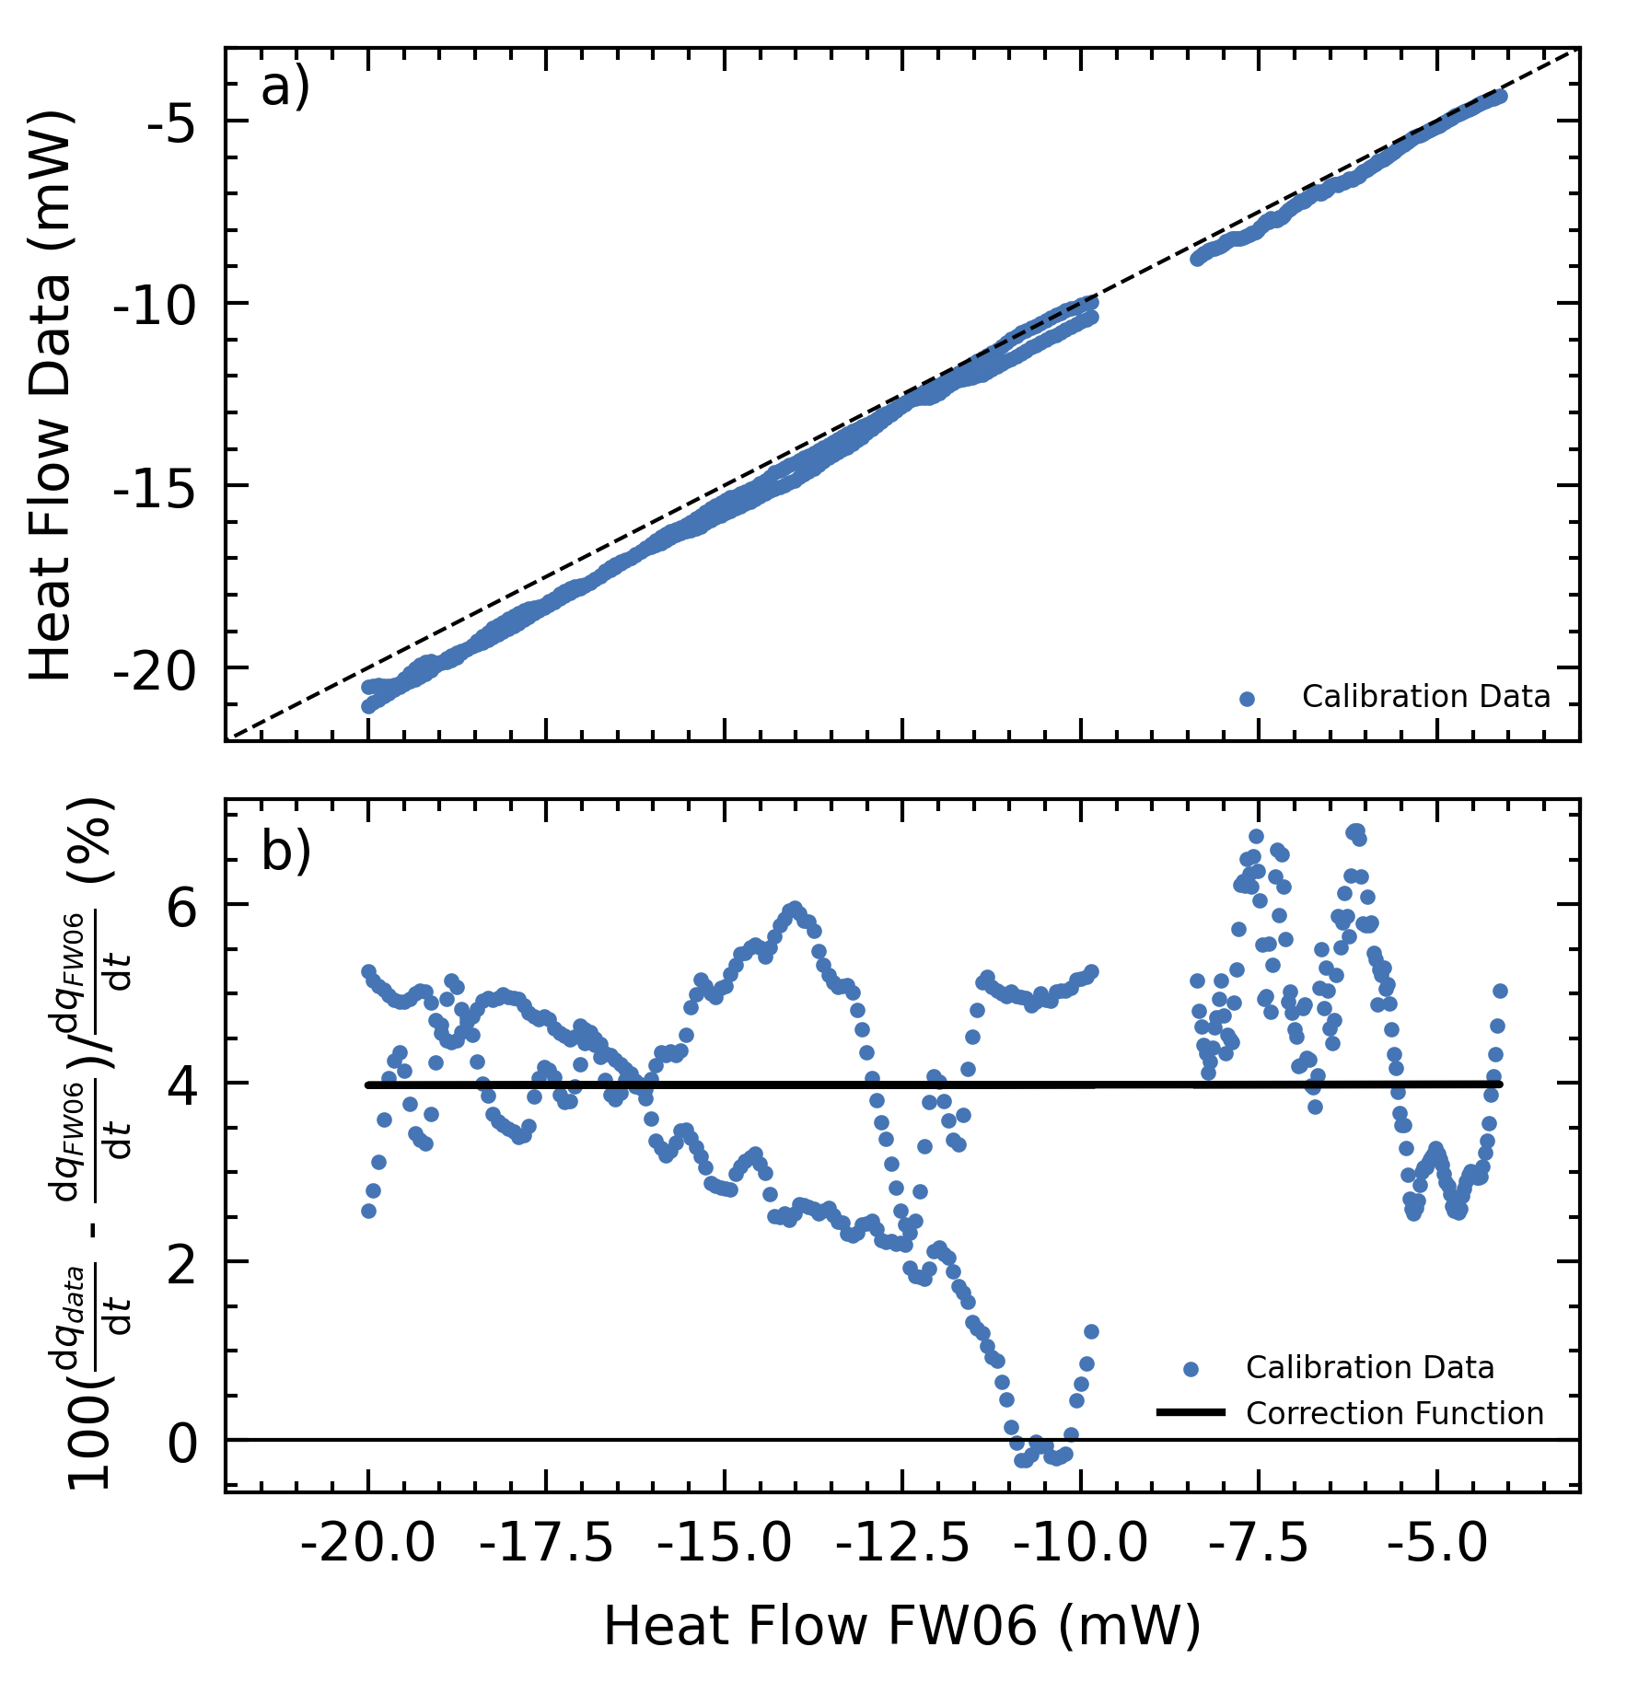
Methods
calibration
Pure water–ice
Systematic deviation from standard EoS by Feistel & Wagner, 2006
Correction function applied to all samples

Slide 10
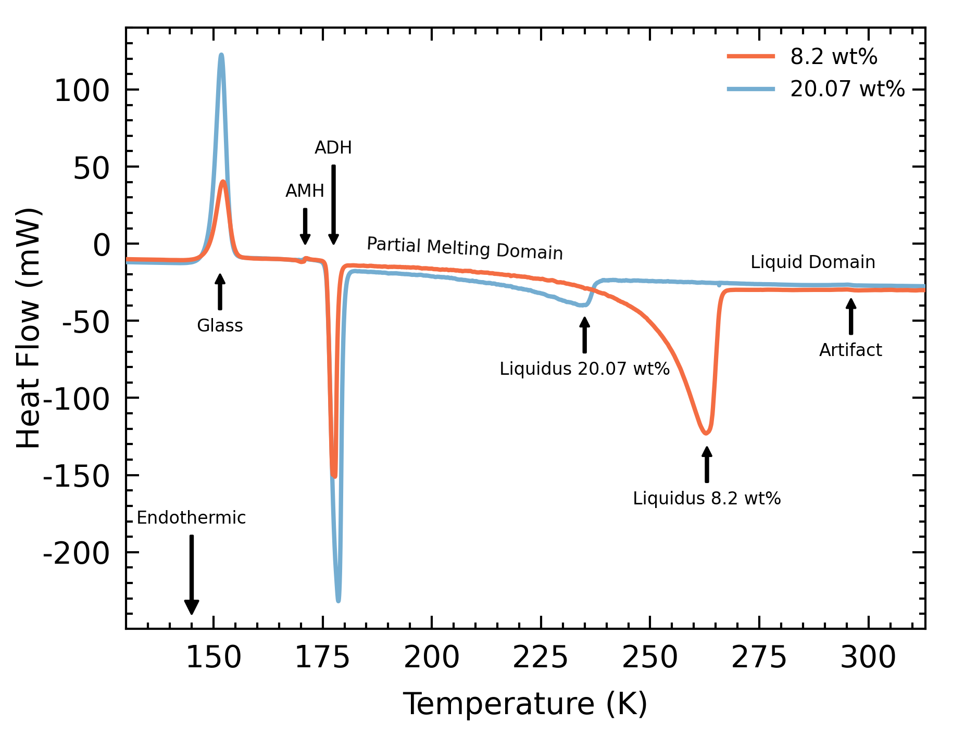
Methods
heat flow thermogram
Liquidus temperature
Determine ammonia concentration
Instrument noise
3-K bin average
Two phase domains
Pure liquid domain
Partial melting domain

Slide 11
Methods
heat flow thermogram
Liquidus temperature
Determine ammonia concentration
Instrument noise
3-K bin average
Two phase domains
Pure liquid domain
Partial melting domain

Slide 12
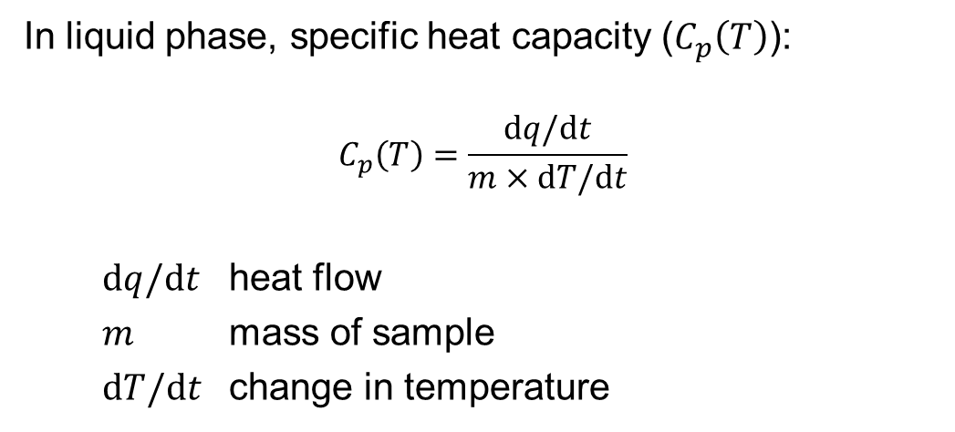
Methods
specific heat extraction
In liquid phase, specific heat capacity ($C_{p}\left(T\right)$):
$$C_{p}\left(T\right)=\frac{dq/dt}{m×dT/dt}$$
$dq/dt$ heat flow
$m$ mass of sample
$dT/dt$ change in temperature

Slide 13
Methods
specific heat extraction
In partial melting domain, multiple processes:
Melting of ice
Heating of ice fraction
Mixing of molten ice with H₂O-NH₃ liquid fraction
Heating of liquid fraction
Assume system in equilibrium

Slide 14
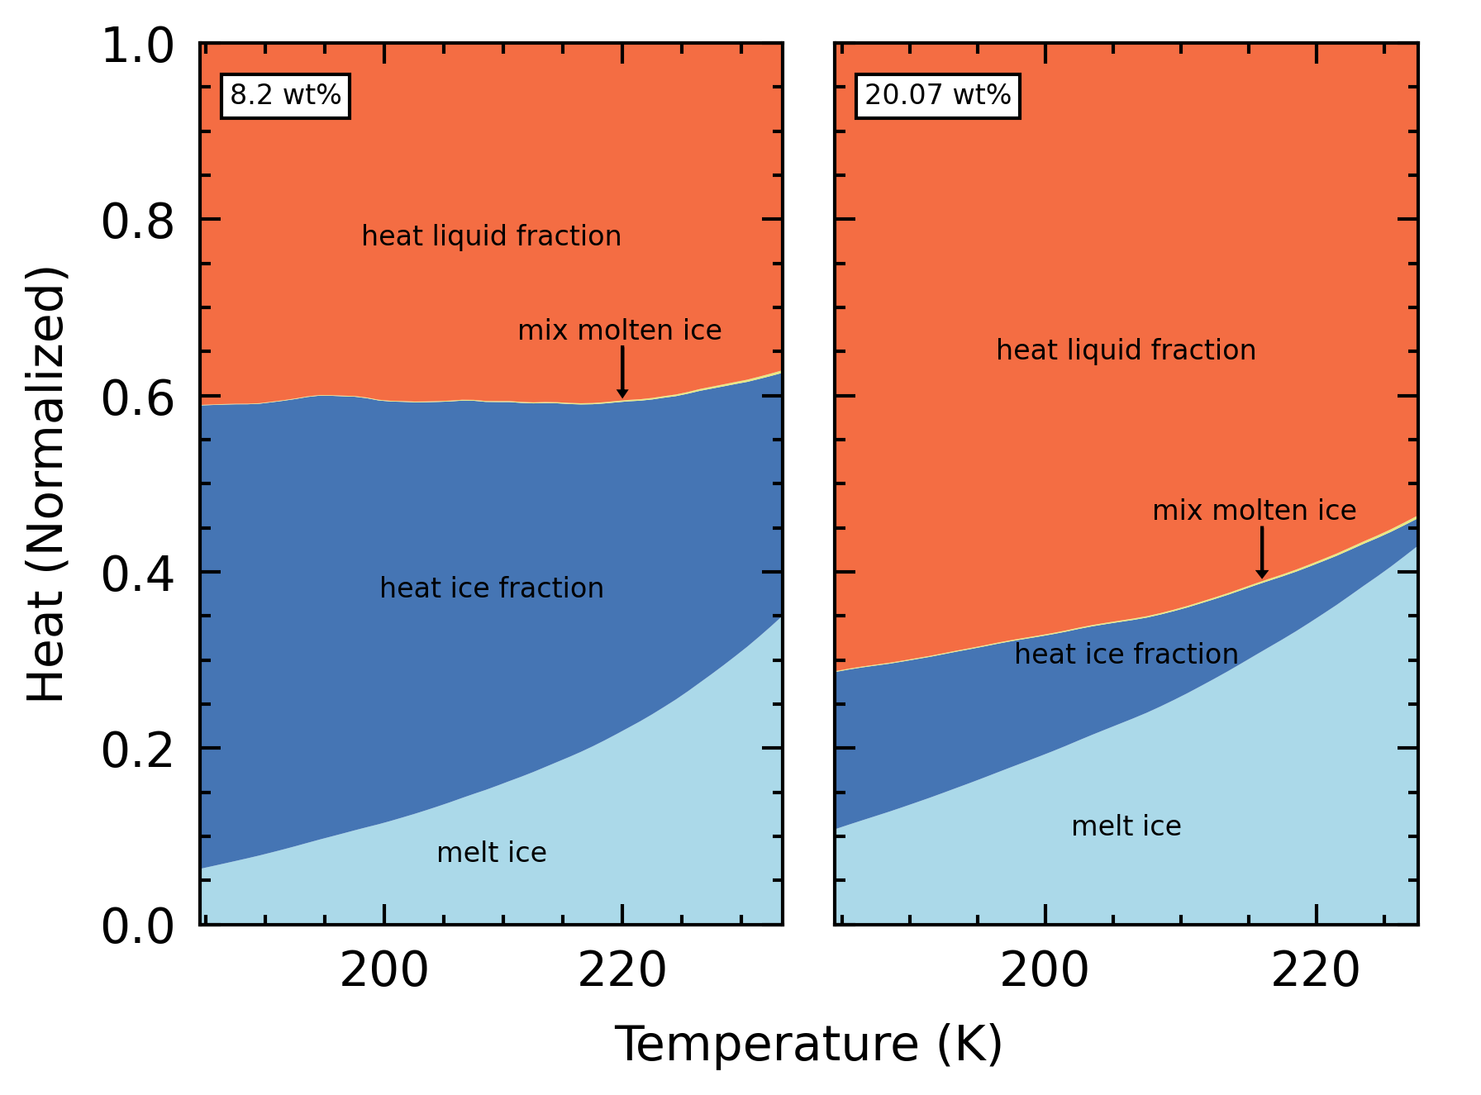
Methods
specific heat extraction
Minimal heat for mixing
Lower concentration → lower proportion to heat liquid fraction
Higher temperature → rapid ice melting → system in disequilibrium

Slide 15
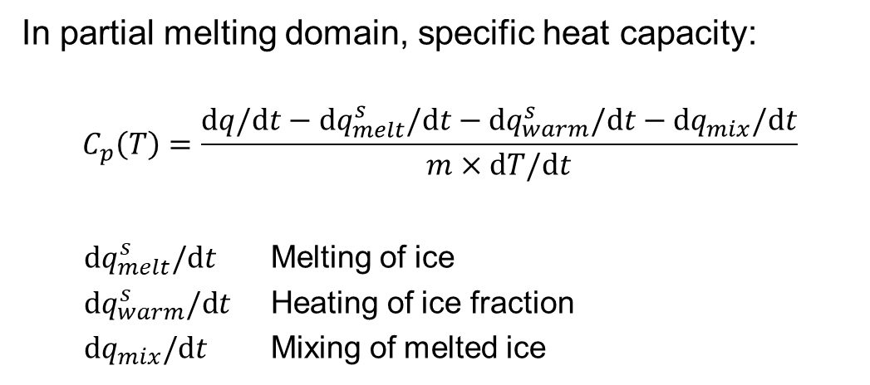
Methods
specific heat extraction
In partial melting domain, specific heat capacity:
$$C_{p}\left(T\right)=\frac{dq/\text{d}t−\text{d}q_{melt}^{s}/\text{d}t−\text{d}q_{warm}^{s}/\text{d}t−\text{d}q_{mix}/\text{d}t}{m×\text{d}T/\text{d}t}$$
$\text{d}q_{melt}^{s}/\text{d}t$ Melting of ice
$\text{d}q_{warm}^{s}/\text{d}t$ Heating of ice fraction
$\text{d}q_{mix}/\text{d}t$ Mixing of melted ice

Slide 16
Methods
overview
Run calorimeter
Apply correction
Deconvolve thermodynamic processes
Calculate liquid phase C_{p}
Calculate partial melting domain C_{p}
Notes:
6:38

Slide 17
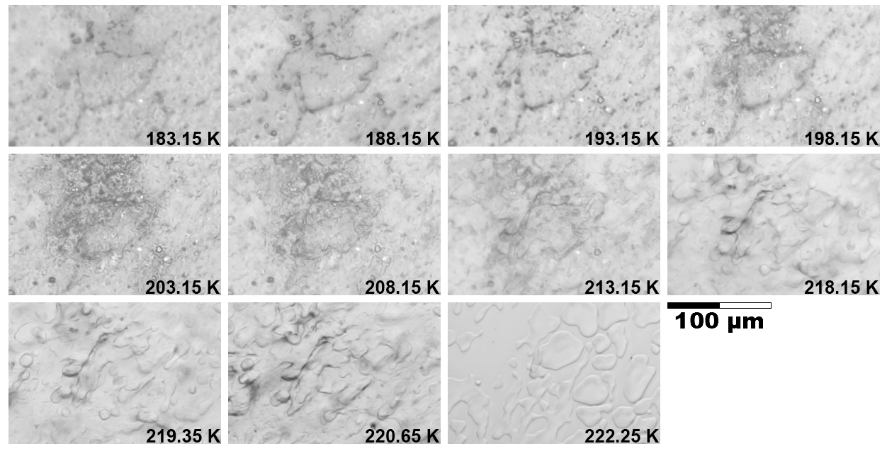
Results
microscopy
Assess equilibrium assumption
Darker regions indicate melt
Melting proceeds gradually, with no crystal regrowth or melt migration
At temperatures close to liquidus, liquid fraction connects, melting proceeds rapidly
~23.6 wt%

Slide 18
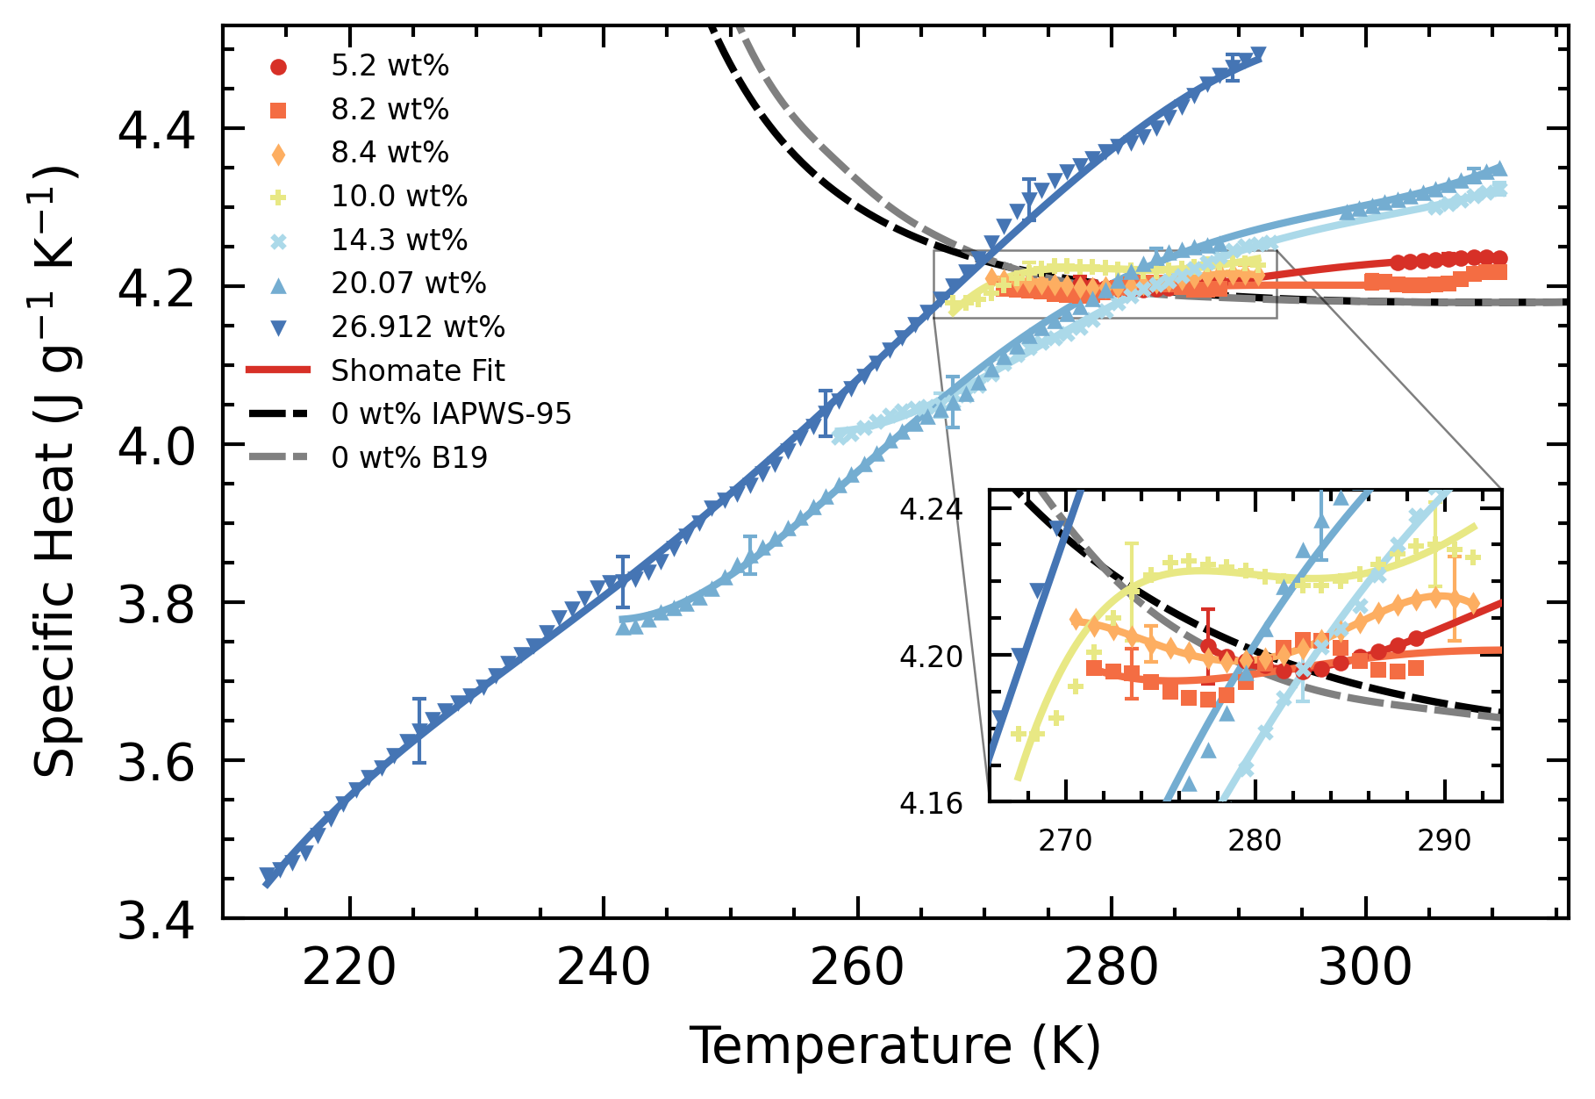
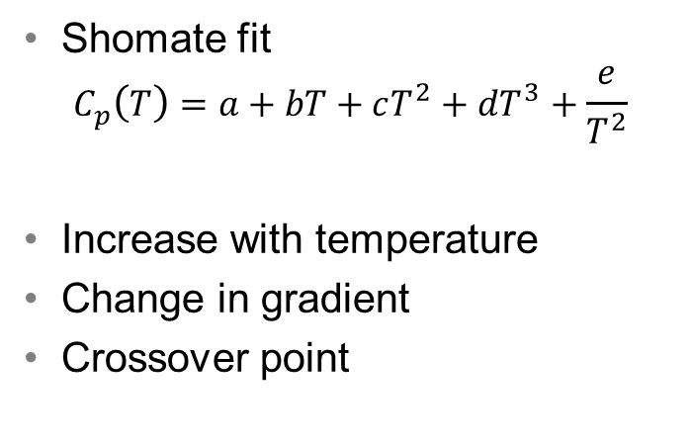
Results
liquid phase C_{p}
Shomate fit
$$C_{p}\left(T\right)=a+bT+cT^{2}+dT^{3}+\frac{e}{T^{2}}$$
Increase with temperature
Change in gradient
Crossover point

Slide 19
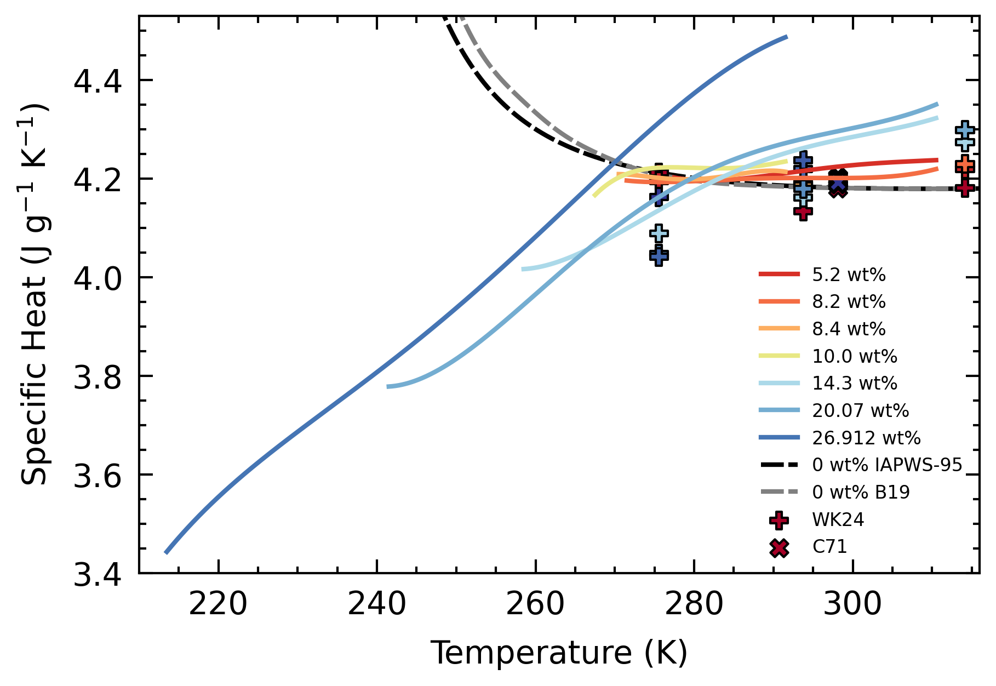
Results
liquid phase C_{p}
Compared with literature values
Wrewsky & Kaigorodoff 1924
Chernen’kaya 1971
General agreement
Magnitude
Trend

Slide 20
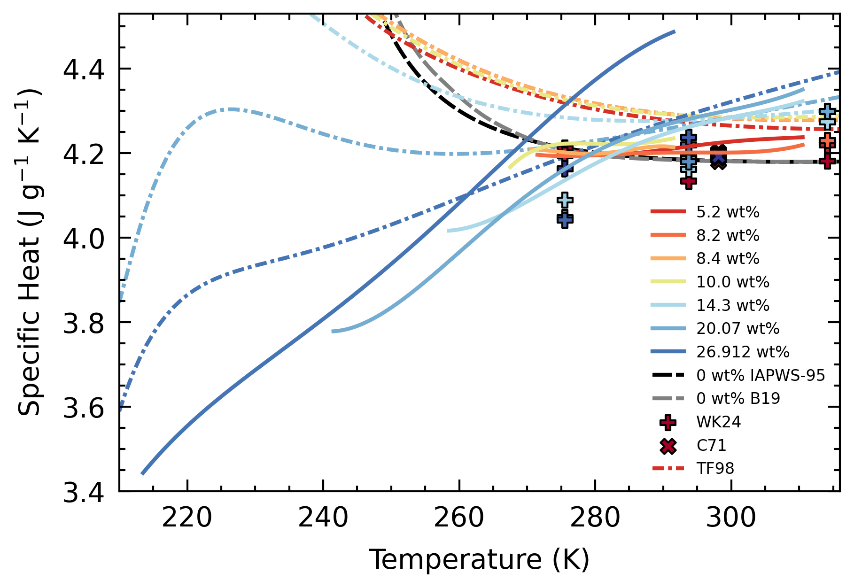
Results
liquid phase C_{p}
Compared with EoS
Tillner-Roth & Friend 1998
Disagreement
Smaller magnitude
Steeper gradient
Lower crossover temperature

Slide 21
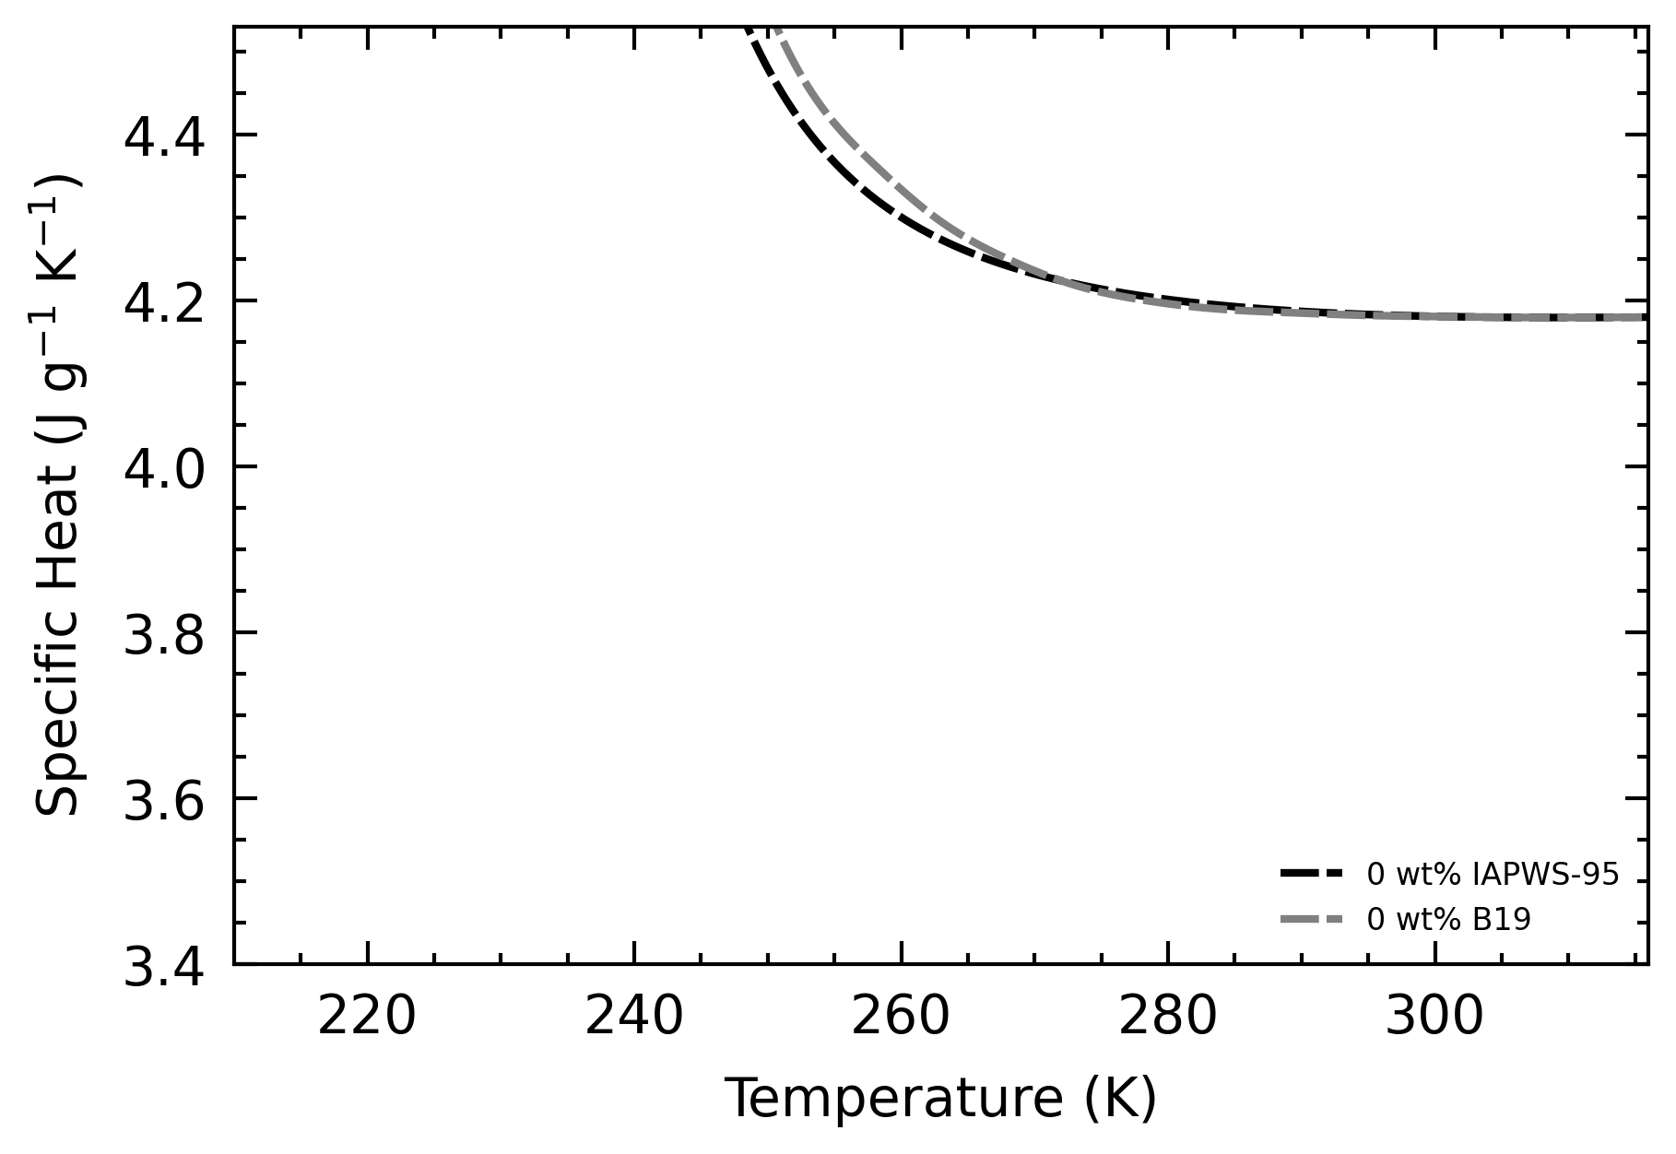
Results
liquid phase C_{p}
EoS is a combination of water and ammonia EoS
Super-cooled state of water
C_{p} increases rapidly

Slide 22
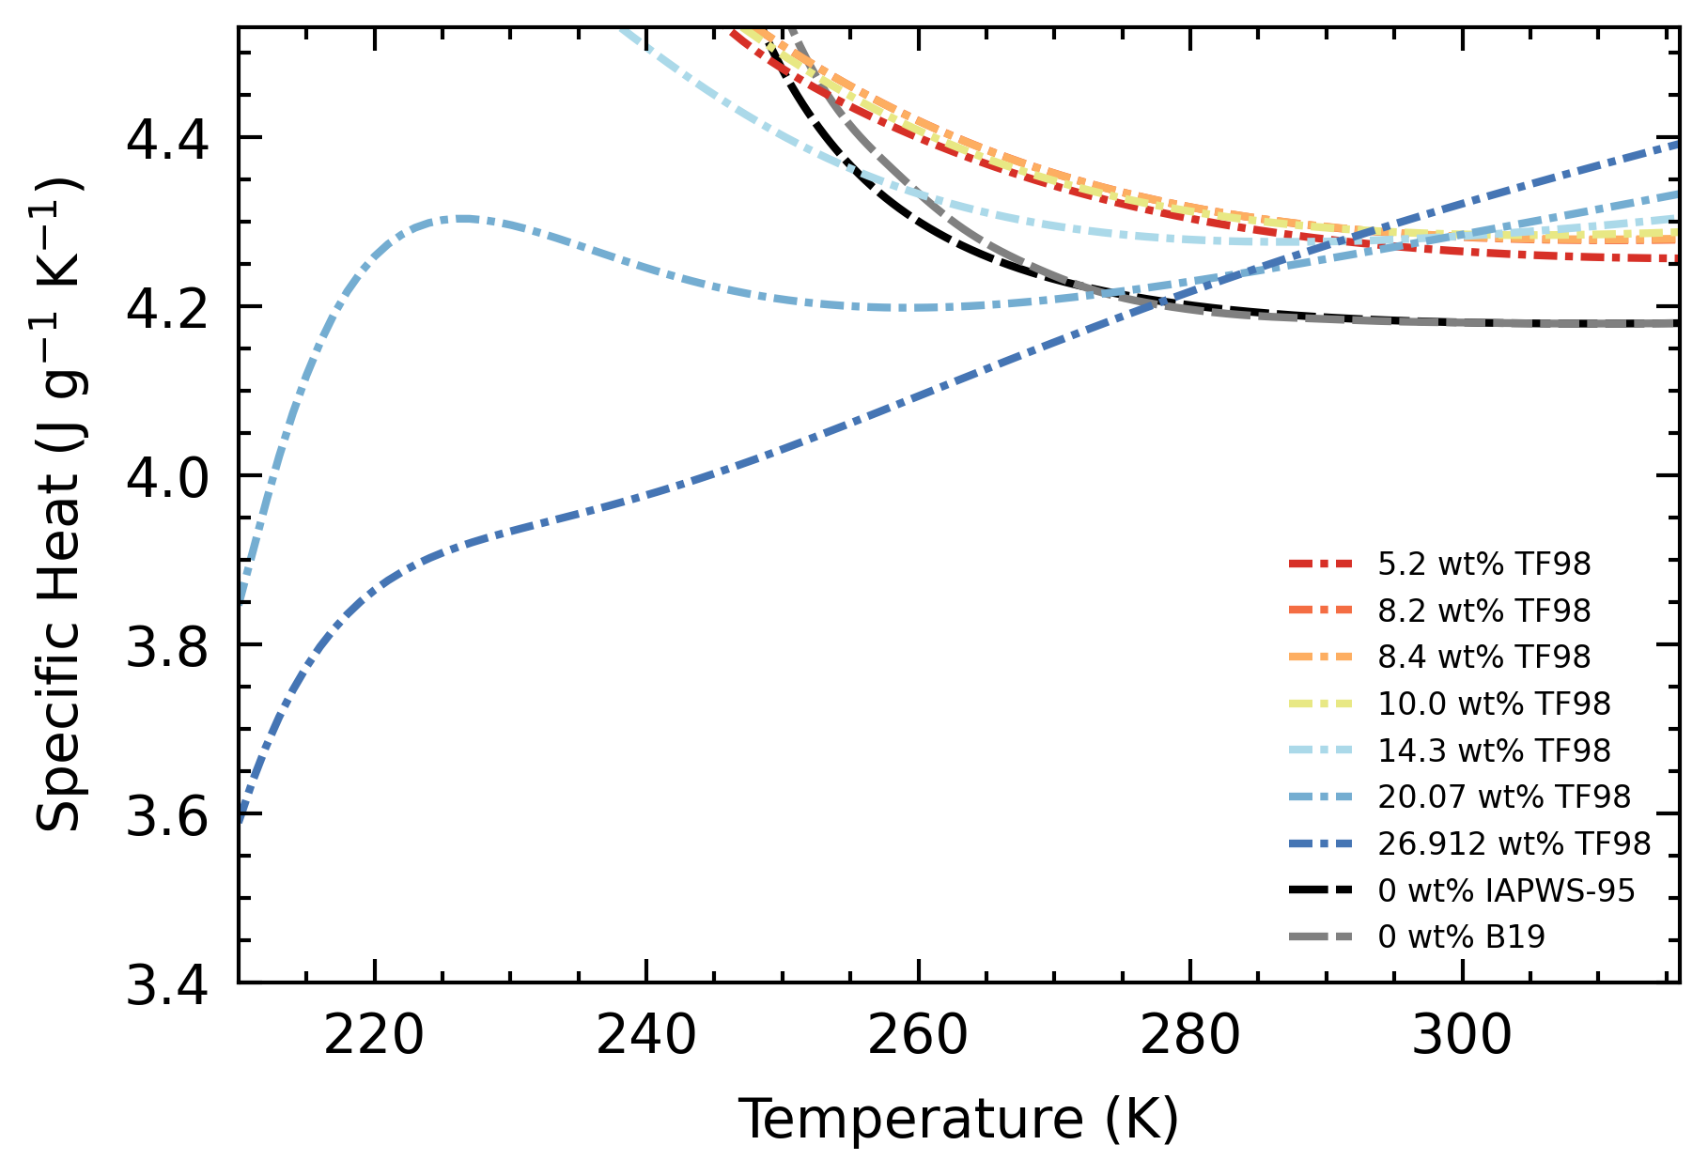
Results
liquid phase C_{p}
EoS is a combination of water and ammonia EoS
Super-cooled state of water
C_{p} increases rapidly
Behavior transposed onto H₂O–NH₃ system
NH₃ suppresses behavior at higher concentrations (arbitrarily set)

Slide 23
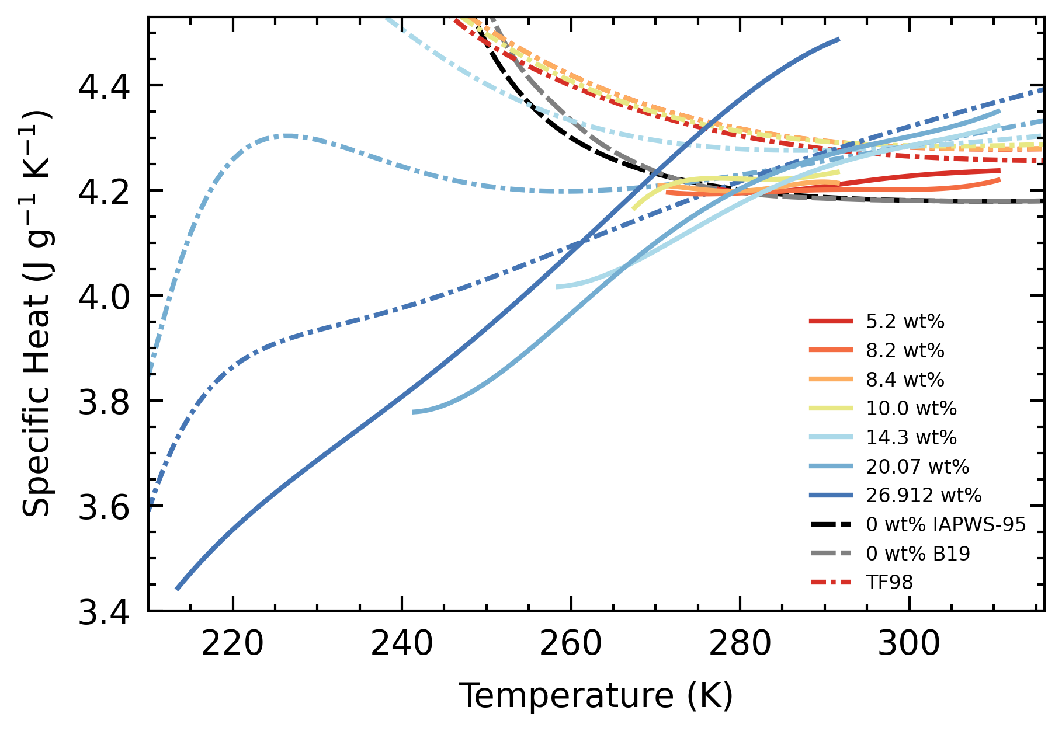
Results
liquid phase C_{p}
EoS is a combination of water and ammonia EoS
Super-cooled state of water
C_{p} increases rapidly
Behavior transposed onto H₂O–NH₃ system
Data suggests a stronger suppression of this behavior

Slide 24
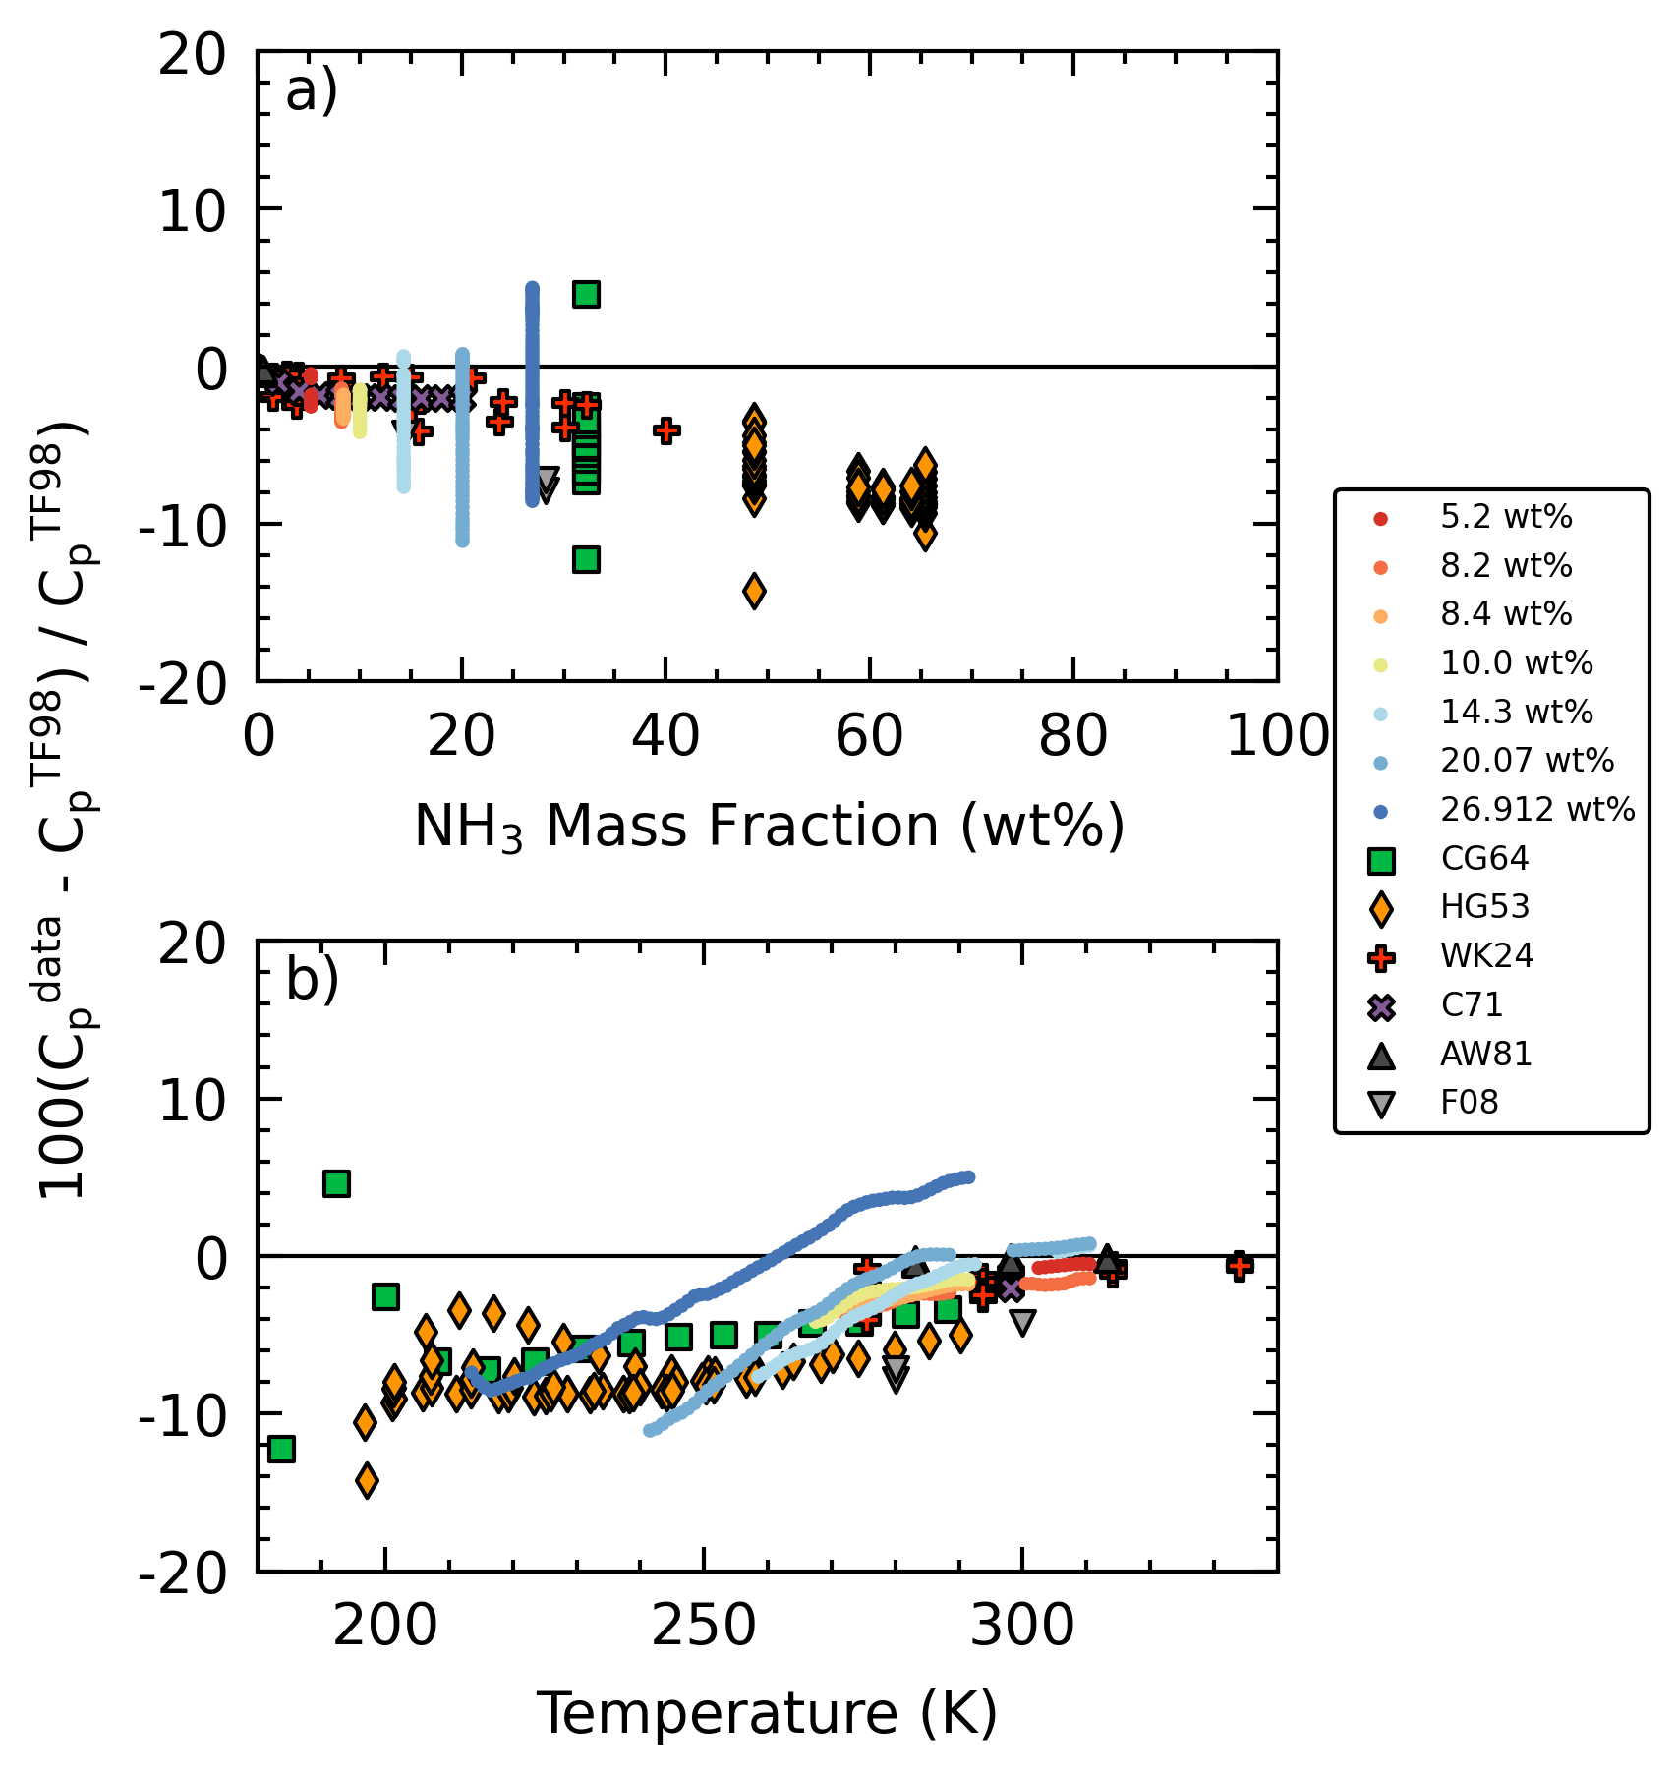
Results
liquid phase C_{p}
Deviations decrease with increasing temperature
Tapers off and stabilize

Slide 25
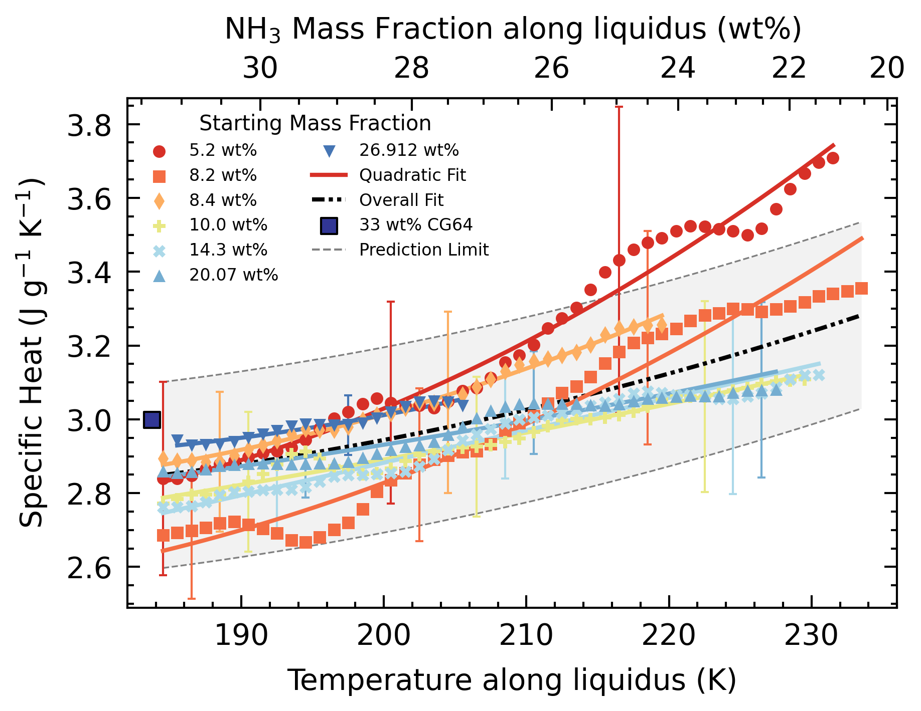
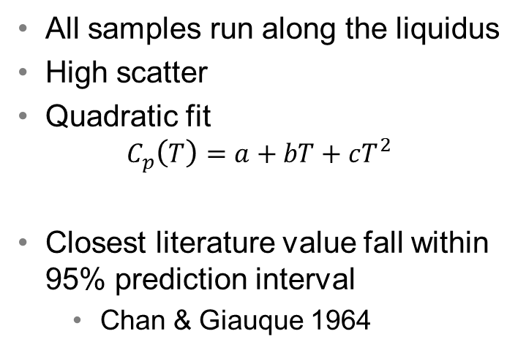
Results
partial melting domain C_{p}
All samples run along the liquidus
High scatter
Quadratic fit
$$C_{p}\left(T\right)=a+bT+cT^{2}$$
Closest literature value fall within 95% prediction interval
Chan & Giauque 1964

Slide 26
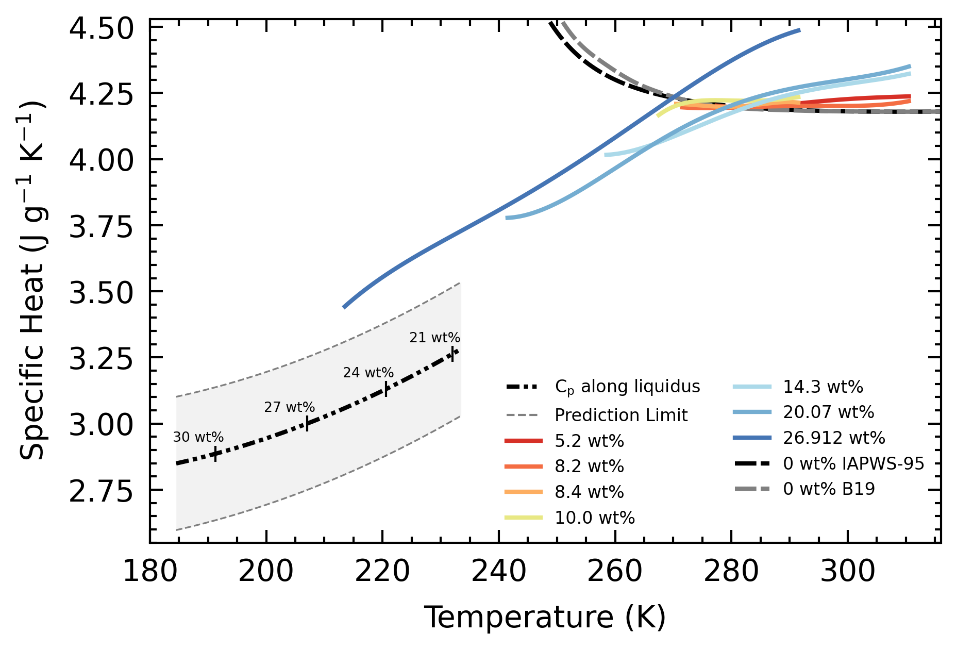
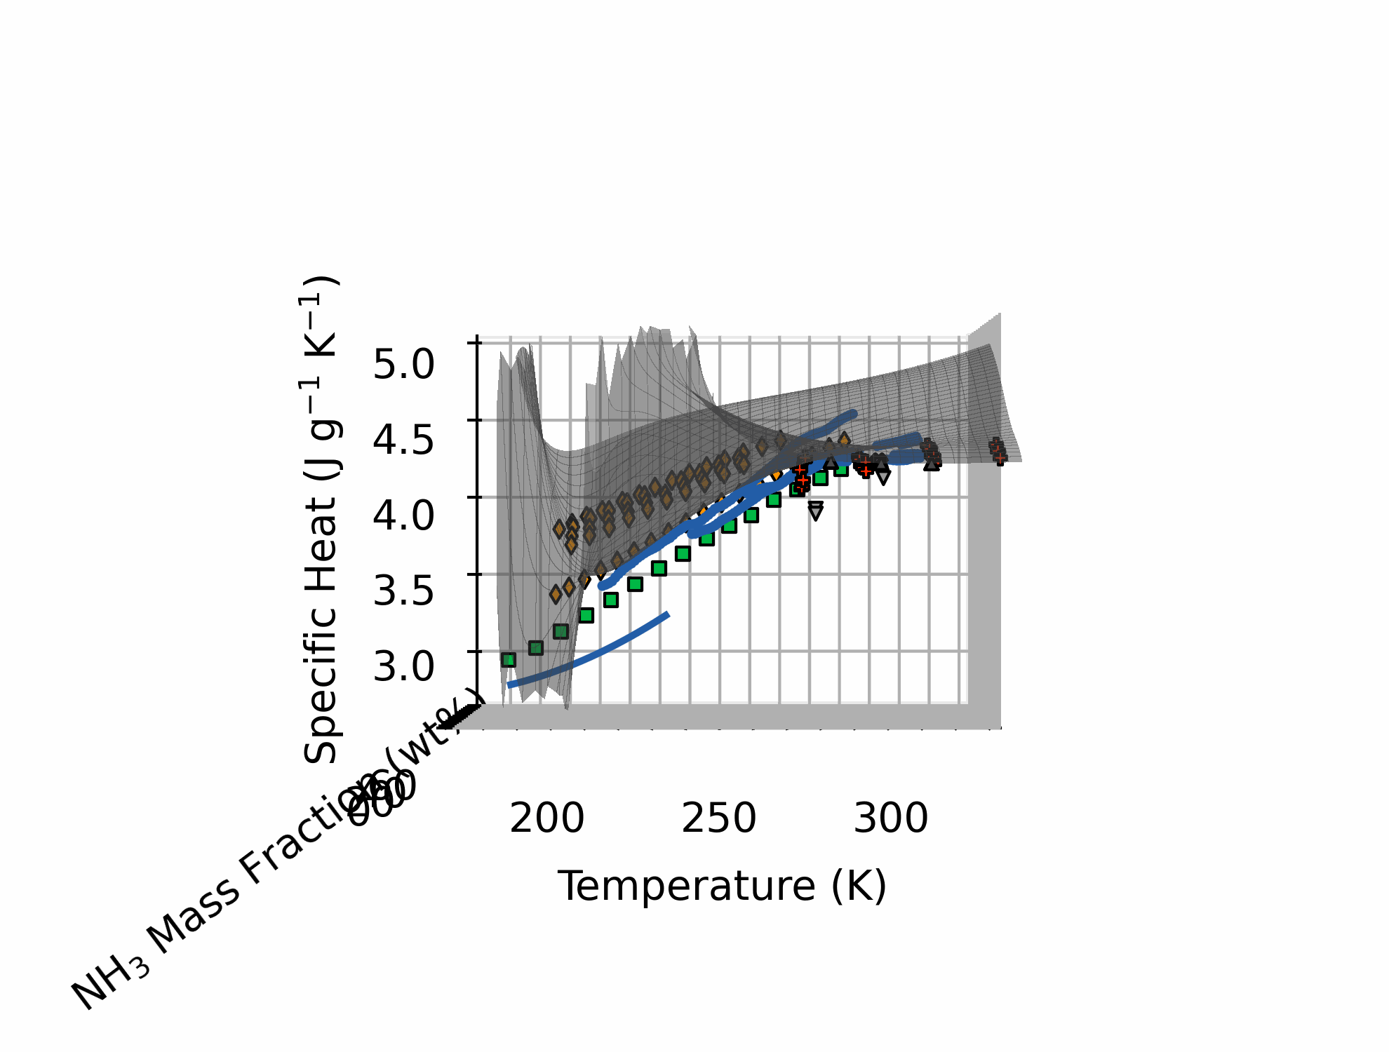
Results
all C_{p}
In theory, along liquidus C_{p} should align with liquid phase C_{p}

Slide 27
Discussion
new equation of state
EoS in development by Journaux et al.
Better constrain the suppression of the critical behavior of super-cooled water at low concentrations
Especially relevant for conditions found on icy moons (< 270 K, < 15 wt%)

Slide 28
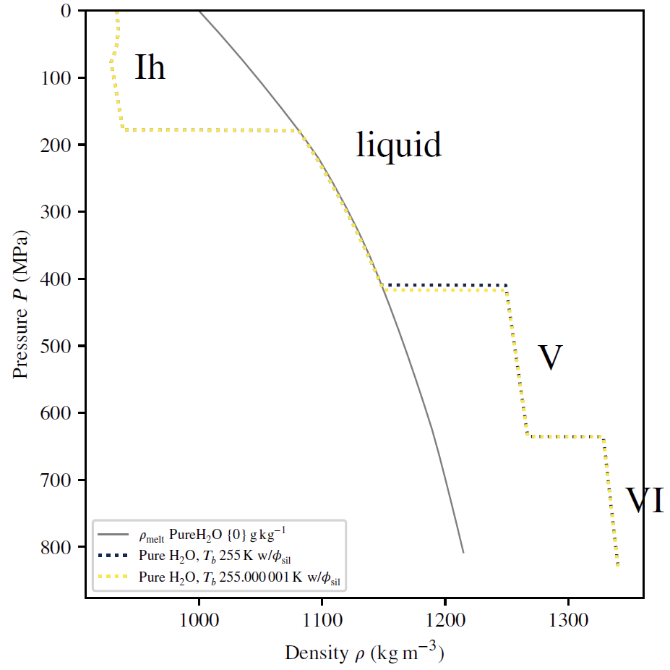
Discussion
interior models
Assess effect of change in C_{p}
Pure water ocean, but with C_{p} modified by deviations of 5.2 wt% from EoS (-3.8 to -1.3 %)
Lower ocean C_{p} → Warmer adiabatic profile → Thicker ocean, thinner high pressure ice (4.55 km)
Original C_{p}
Modified C_{p}

Slide 29
Discussion
interior models
Only tests C_{p} change
New EoS, other properties are also modified
Original C_{p}
Modified C_{p}

Slide 30
Conclusion
Realistic Geophysical Models
Robust Equations of State (EoS)
Accurate Thermodynamic Data
isobaric specific heat capacity (C_{p})

Slide 31
Conclusion
Inform Science Objectives
Realistic Geophysical Models
Robust Equations of State (EoS)
Accurate Thermodynamic Data
isobaric specific heat capacity (C_{p})

Slide 32
Key References
Chan, J. P.; Giauque, W. F. The Entropy of NH3·2H2O. Heat Capacity from 15 to 300°K.1. The Journal of Physical Chemistry 1964, 68, 3053–3057.
Croft, S.; Lunine, J.; Kargel, J. Equation of state of ammonia-water liquid: Derivation and planetological applications. Icarus 1988, 73, 279–293.
Feistel, R.; Wagner, W. A New Equation of State for H2O Ice Ih. Journal of Physical and Chemical Reference Data 2006, 35, 1021–1047.
Journaux, B.; Brown, J. M.; Pakhomova, A.; Collings, I. E.; Petitgirard, S.; Espinoza, P.; Ballaran, T. B.; Vance, S. D.; Ott, J.; Cova, F.; Garbarino, G.; Hanfland, M.Holistic Approach for Studying Planetary Hydrospheres: Gibbs Representation of Ices Thermodynamics, Elasticity, and the Water Phase Diagram to 2, 300 MPa. Journal of Geophysical Research: Planets 2020, 125.
Journaux, B.; Brown, J. M.; Abramson, E.; Vance, S. The thermodynamics of ammonia rich planetary oceans: Equation of State for water-ammonia and water-ammonia-salt solutions from surface to abyssal conditions. AGU Fall Meeting Abstracts. 2021; pp P44A–08.
Styczinski, M. J.; Vance, S. D.; Melwani Daswani, M. PlanetProfile: self-consistent interior structure modeling for terrestrial bodies in python. submitted to Earth and Space Science, 2022. DOI: 10.1002/es- soar.10512890.1
Tillner-Roth, R.; Friend, D. G. A Helmholtz Free Energy Formulation of the Thermodynamic Properties of the Mixture {Water + Ammonia}. Journal of Physical and Chemical Reference Data 1998, 27, 63–96.
Vance, S. D.; Panning, M. P.; Stahler, S.; Cammarano, F.; Bills, B. G.; Tobie, G.; Kamata, S.; Kedar, S.; Sotin, C.; Pike, W. T.; Lorenz, R.; Huang, H.-H.; Jackson, J. M.; Banerdt, B. Geophysical Investigations of Habitability in Ice-Covered Ocean Worlds. Journal of Geophysical Research: Planets 2018, 123, 180–205.
Wagner, W.; Pruß, A. The IAPWS formulation 1995 for the thermodynamic properties of ordinary water substance for general and scientific use. Journal of physical and chemical reference data 2002, 31, 387–535.
Wrewsky, M.; Kaigorodoff, A. I. Warmekapazitat wasseriger Losungen von Chlorwasserstoff und Ammoniak bei verschiedenen Temperaturen. Zeitschrift fur Physikalische Chemie 1924, 112U, 83–89.

Slide 33
Acknowledgements
Mentors – Steve, Mathieu, Mohit, Elodie, Tuan, Marshall, Baptiste for the guidance
MoonsGG – for the exposure
Peers – summer, fall, winter interns for the company
JPL & Benoit – for the opportunity

